Slide 1
END to END Protection (E2E)
Sudha P Kalagi

Slide 2
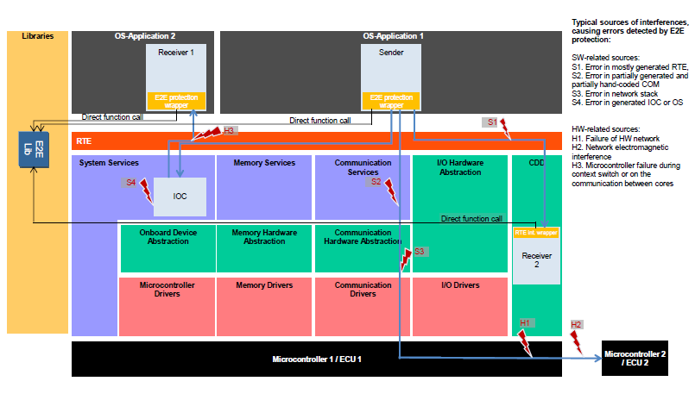
WHY E2E ??
End-to-end encryption (E2EE) is a method of Safe communication that prevents unintentional corruption of data while it's transferred from one end system or device to another.
The E2E Protection target to mitigate the faults arising from
Random HW faults (corrupt registers of a CAN transceiver)
Interference (due to EMC)
Systematic faults of the lower communication layers (RTE, IOC, COM and network stacks).

Slide 3

Transmitter
Data
E2E
Data
Header TX
Header
CRC
SQC
Receiver
Data
Header TX
E2E
Header RX
?
Header TX
NO
YES
Next Module
Data

Slide 4
E2E Protection
The E2E communication protection allows the following
It protects the safety-related data to be sent by adding control data
It verifies the safety related data received using this control data
Provides result to the receiver, based on that the receiver accept the data to higher layers
Introduction : E2E Library
The callers of the E2E Library are responsible for the correct usage of the library.
The E2E library is invoked from:
1. E2E Transformer (a new, standardized way to invoke E2E, introduced in R4.2.1)
2. E2E Protection Wrapper
3. COM E2E Callout.

Slide 5
E2E usage with Autosar
Regardless where E2E is executed, the E2E protection is for data elements. The E2E protection is performed on the serialized representation of data elements, on the same bit layout as the one transmitted on the bus.
In case E2E transformer is used, the serialization is performed by COM-Based Xf
In case E2E Protection Wrapper is used, the wrapper needs to serialize the data element into the serialized form of the corresponding signal group
In case the COM callout is used, the serialization is done by communication stack (RTE,COM), so COM callout directly operates upon serialized signal groups in I-PDUs

Slide 6
E2E Transformer
E2E transformer is responsible for protecting safety-related data elements.
It is invoked by RTE.
Both serialize/linearize data (transform them from a structured into a linear form) and transform (modify or extend linear data).
It is possible to connect a set of transformers together into a transformer chain. The RTE coordinates the execution of the transformer chain and calls the transformers of the chain exactly in the specified order.
E2E transformer invokes E2E Library
Note:
If a receiving SWC doesn’t read the transformer return codes, it is fully transparent to the communicating SWCs whether the data are E2E protected on the bus or not.

Slide 7
E2E Library
E2E library shall provide E2E profiles, where each E2E profile completely defines a particular safety protocol
The E2E profiles provide a consistent set of data protection mechanisms, designed to protecting against the faults considered in the fault model.
Each E2E profile provides an alternative way to protect the communication, by means of different algorithms.
Each E2E Profile shall use a subset of the following data protection mechanisms:
A CRC, provided by CRC library;
An Alive Counter
A specific ID for every port data element sent over a port or a specific ID for every I-PDU group
Timeout detection:
1. Receiver communication timeout;
2. Sender acknowledgement timeout.

Slide 8
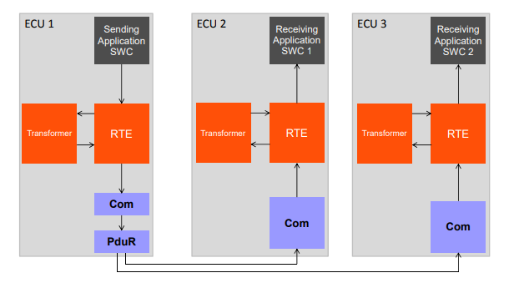
Overview of E2E communication protection between a sender and a receiver
Serializer
De-Serializer
De-Serializer
Safety
Safety
Safety
E2E library
E2E library
E2E library
Safety(E2E transformer), serializer – Com based Xf

Slide 9
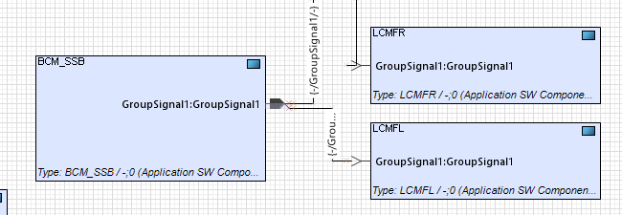
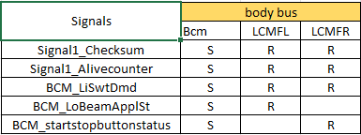
E2E demo and modelling

Slide 10
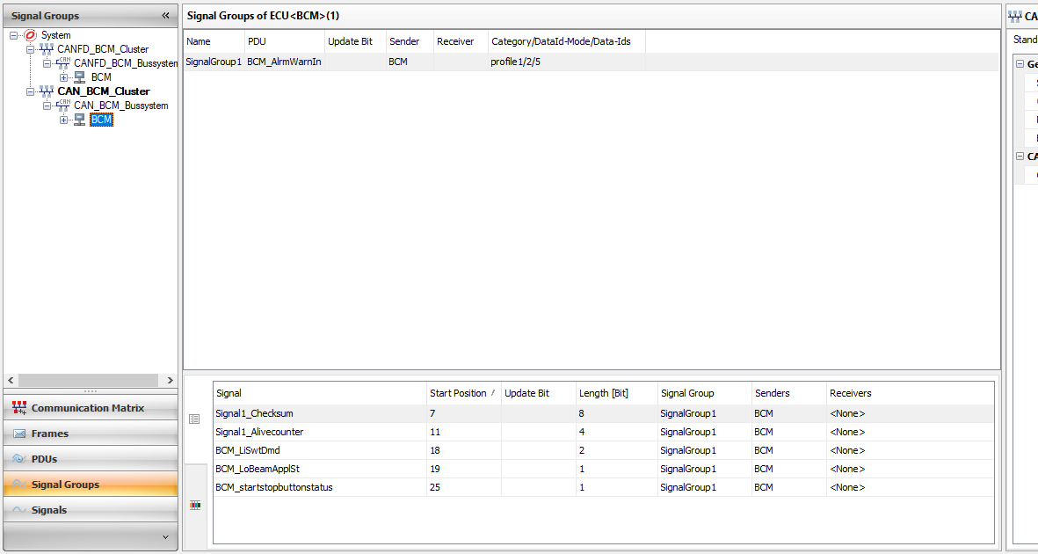
Arxml Exports
E2E specific parameters

Slide 11
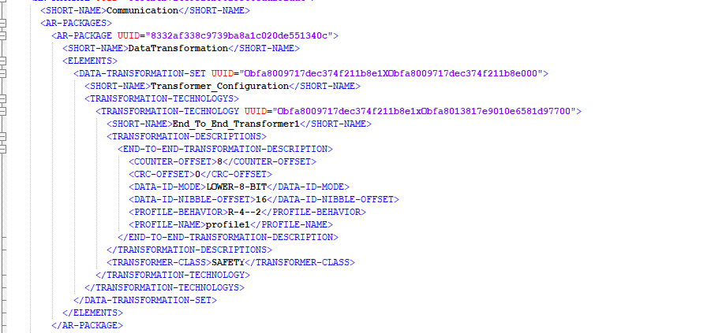

Slide 12
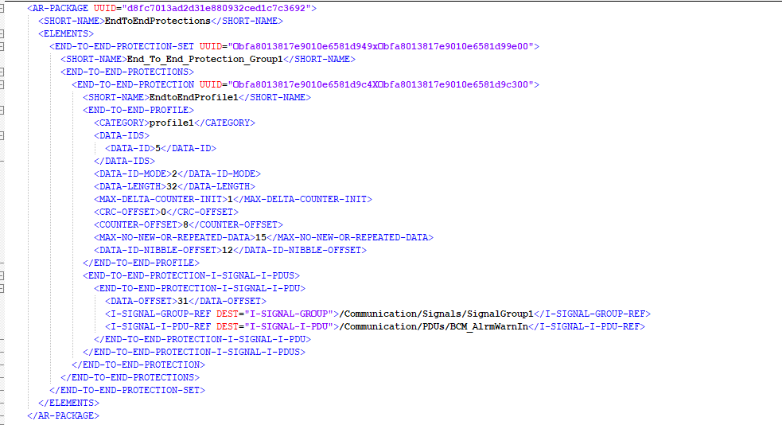

Slide 13
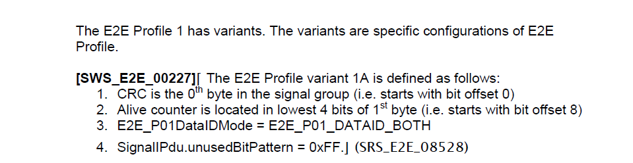
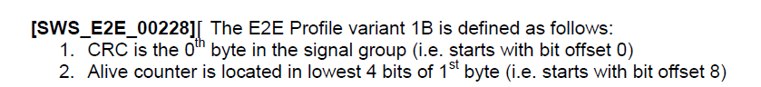

E2E profile examples

Slide 14
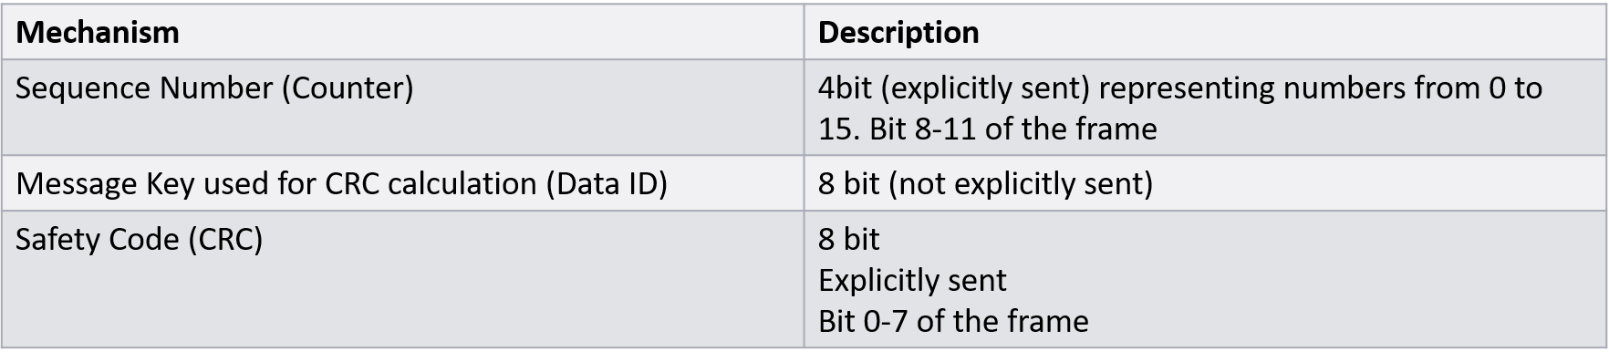
E2E: Profile2
In E2E Profile 2, the layout of the data buffer (Data) shall be as depicted in below, with a maximum length of 256 bytes

Slide 15
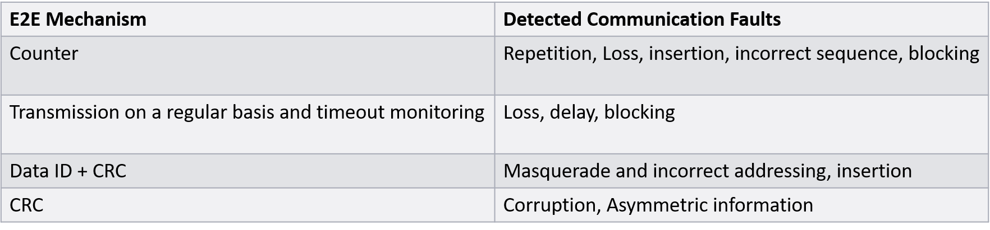
E2E Profile2: Faults Detected
Note: The mechanisms provided by Profile 2 enable the detection of the relevant failure modes except message delay

Slide 16
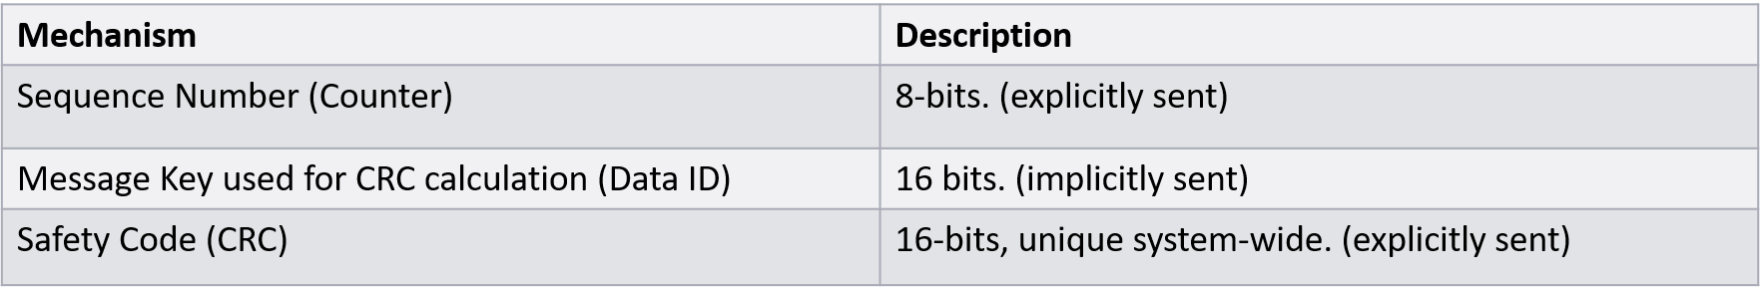
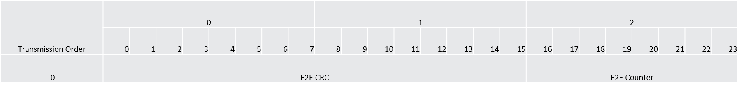
E2E: Profile5

Slide 17
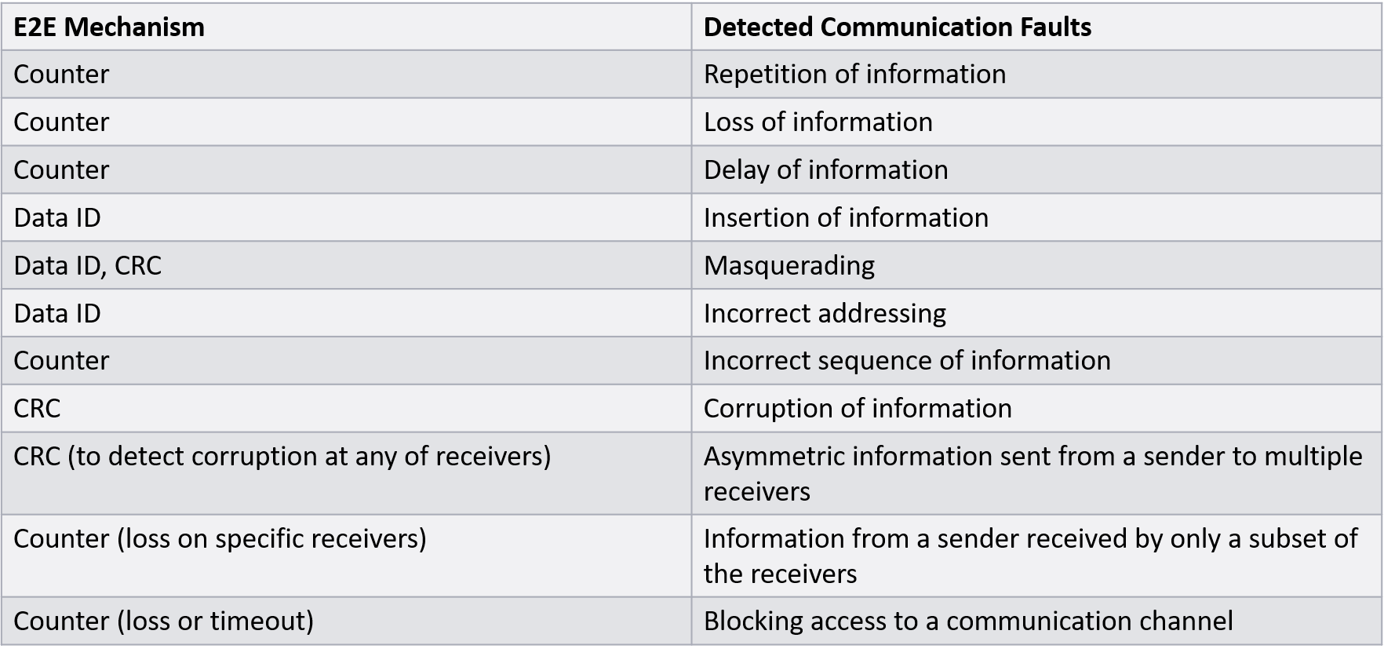
E2E Profile5: Faults Detected

Slide 18
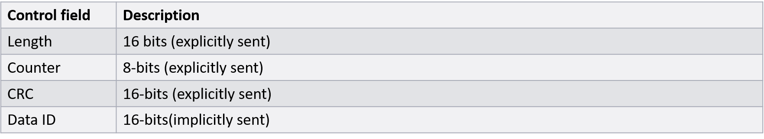
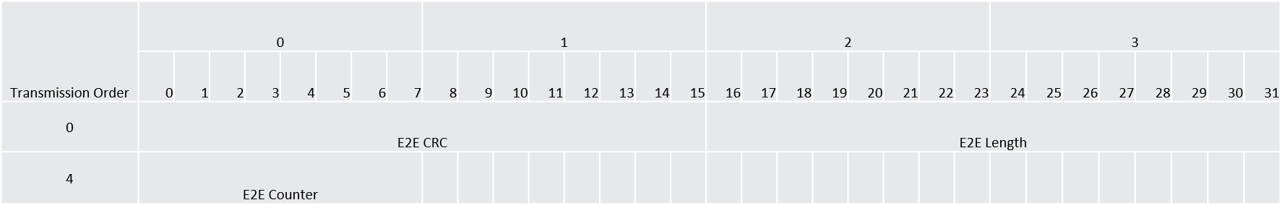
E2E: Profile6

Slide 19
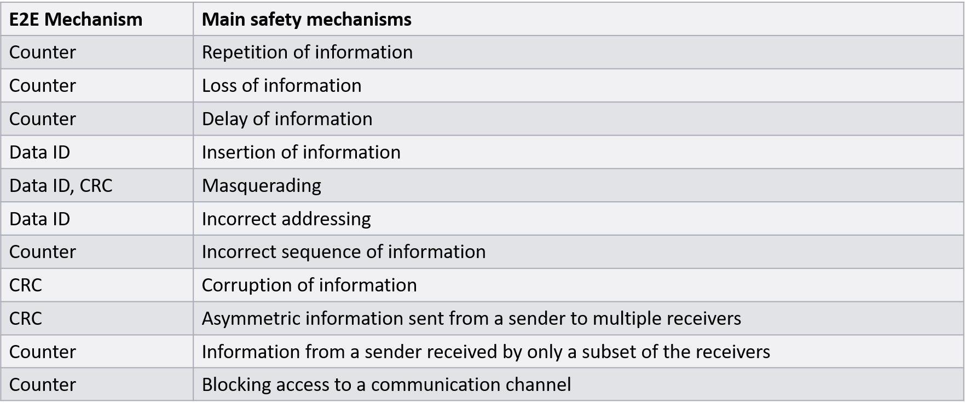
E2E Profile6: Faults Detected

Slide 20
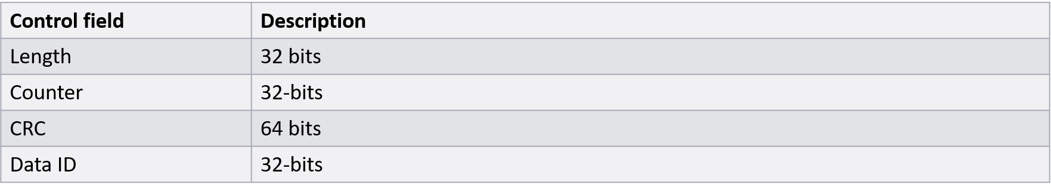
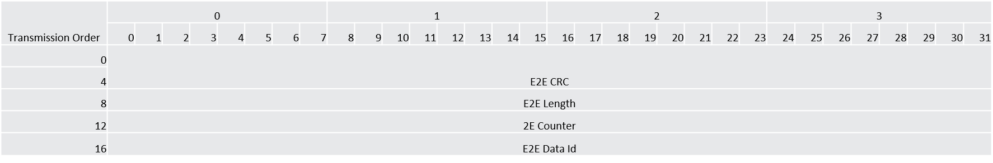
E2E: Profile7

Slide 21
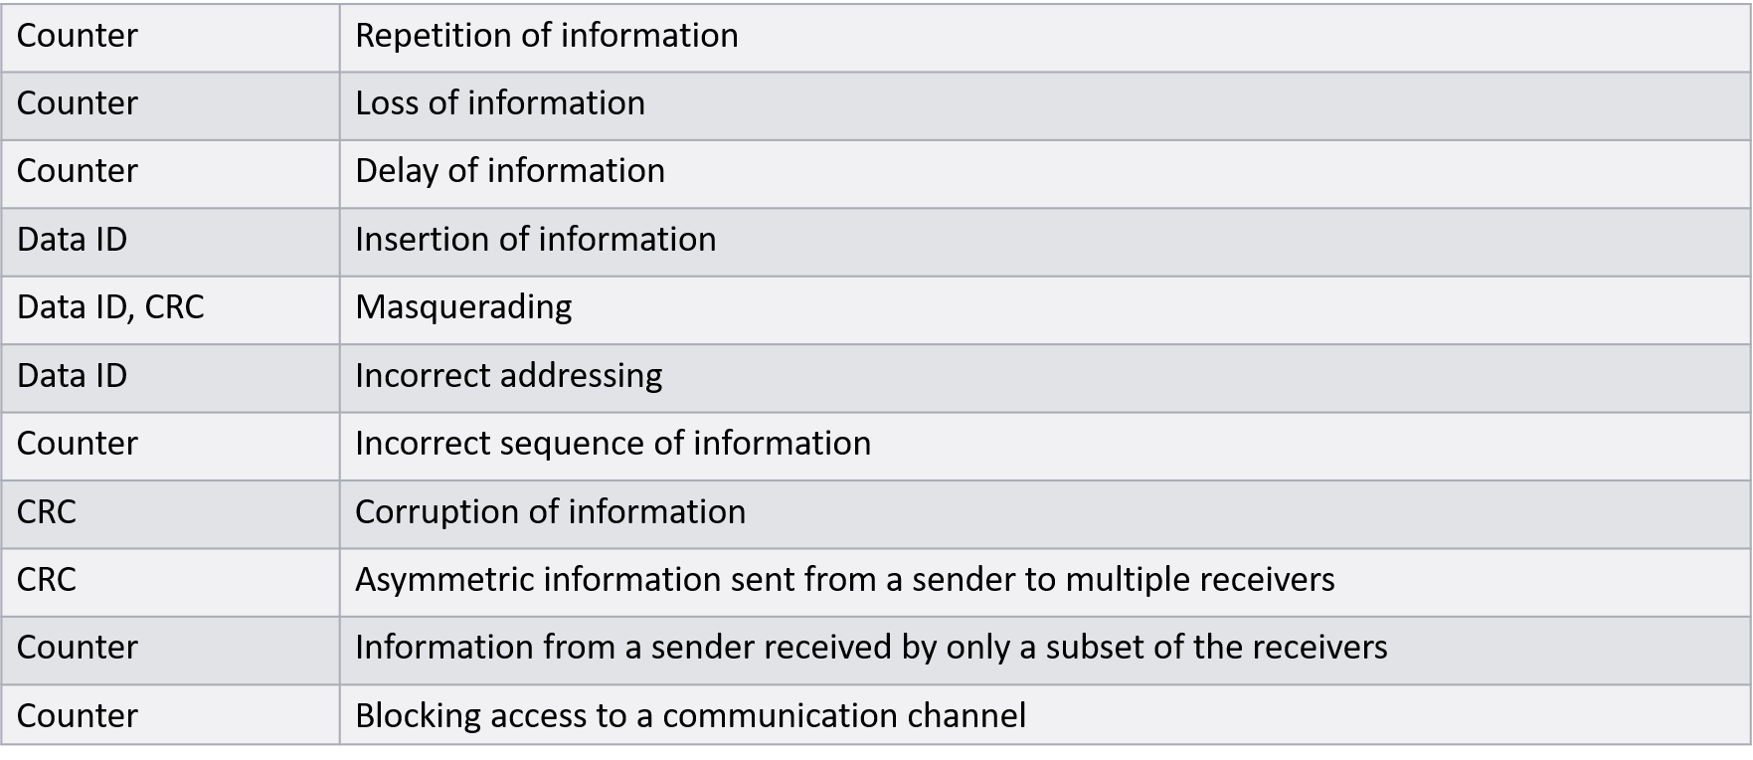
E2E Profile7: Faults Detected

Slide 22
Limitations
E2E communication protection is limited to periodic or semi-periodic data communication paradigm, where the receiver (subscriber) has an expectancy on the regular reception of data and in case of communication loss/timeout or error, it performs an error handling.
This means, a protection of client-server (methods) as well as non-periodic data communication (E.g. transmission only on occurrence of a specific event) are not supported by E2E communication protection.

